Slide 1
S.A. Matasov
Forward
Home
PROSPECTS OF COLON CANCER SCREENING AND TREATMENT
Part 4. ANTISEPTIC METHOD OF 1-MOMENT COLON RESECTION
Aseptics, antiseptics?
It’s ignored nightmare in coloproctology!
From the conversation in operation room.
Contents of slides
Contents of slides.
Mortality and anastomotic leak following operations on large intestine.
Miasmas of large intestine - the main reason of anastomotic leak.
Palpatory intestinal trauma – the second reason of anastomotic leak.
Ideology and differences of Antiseptic method.
Intestinal Intubator with Drain-Irrigator (IIDI); intubational system “Pull-&-Push”.
IIDI; intubation management.
IIDI; lavage system “Stream”.
IIDI; aspiration system “Drain-Irrigator”.
Algorithm of new 1-moment colon resection.
Clinical estimation of Antiseptic method.
Conclusion.
13, 14. Main sources of information.
© Reference on www.coloncancer.lv is obligatory
1

Slide 2
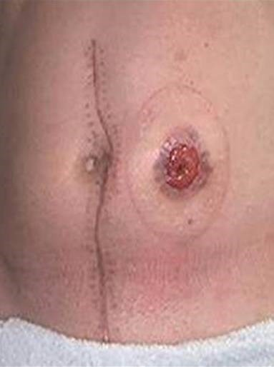
Prospects of colon cancer screening and treatment
Antiseptic method of 1-moment colon resection
2. Mortality and anastomotic leak following operations on large intestine
Mortality figures after large intestine cancer operations are highly heterogeneous. For example, according to Germany data, during 30 days after primary anastomosis died 12% of patients, and after Hartmann operation - 25% [1]; in an article from UK the last figure is higher - 30% [2]. Usually: 6-39% [3], 6-22% [4], 25% [5] of mortality is associated with anastomotic leak.
An average leak rate of 11% [6] disorientates. Being increased as anastomosis shifts down, a leak after rectal resections reached 50% [6]; other data are much lower: 10-20% [7], 15% [8], 2,5-20% [9], 6-30% [10]. High data dispersion excludes its generalization, requires a particular analysis of each of five colon resection methods.
A leak is the result of poor preparation of large intestine for application of anastomosis. The impossibility of its emptying and lavage in case of ileus has born 4 groups of combined methods, including acts of intestines formation for withdrawal of contents. However, both primary and secondary anastomosis, as well as unloading stoma, are leaking. It should be noted that forming, keeping, closing of stoma requires considerable efforts.
© Reference on www.coloncancer.lv is obligatory

Slide 3
Prospects of colon cancer screening and treatment
Antiseptic method of 1-moment colon resection
3. Miasmas of large intestine - the main reason of anastomotic leak
The frequency of inflammation-suppuration of the surgical wound after large intestine resection has some proximity to the figures of anastomotic leak: 13,7% [11], 12,5% [12], 23,5% [13], which can be explained by common reasons and pathogenesis of these complications. The reasons lies in violation of general surgery rules: aseptics, antiseptics, atraumatic manipulations. The general pathogenesis ends by formation of a purulent cavity; opening of anastomotic ligature abscess under pressure in intestine will lead to leak.
Aseptics is a method of surgical work which provides prevention of entry of microbes into the surgical wound.
Antiseptics is a system of measures which reduce the number of microbes in a wound, the threat of their penetration into the wound and development inside it.
200 years of aseptics and antiseptics have not given any technologies which provide large intestine disinfection. Its infection rate after on-table lavage with antegrade or retrograde systems such as Coloclean [14], [11], Retrowash [15] is convincingly illustrated by the data of colonoscopes processing [16]:
Contamination of apparatus after procedure is approaching to 9 units (lg CFU/ml).
Washing with water reduces its infection rate by 20%.
High-level disinfection (HLD) approache contamination of colonoscope to 0.
Thus, in connection with unreality of large intestine’s HLD and the possibility to reduce its contamination at best by 20%, anastomoses are formed in an microbial environment; if the cavity was prepared, intestinal sutures will "breath" by it, if there was an ileus and afferent loops enclose liters of a microbial suspension, sutures will plunge into it.
© Reference on www.coloncancer.lv is obligatory

Slide 4
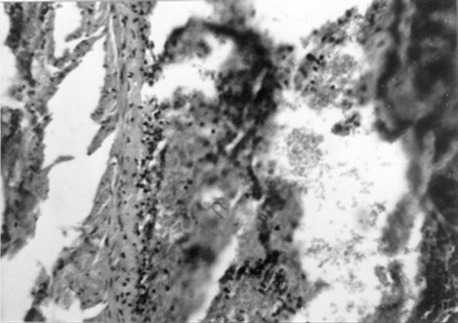
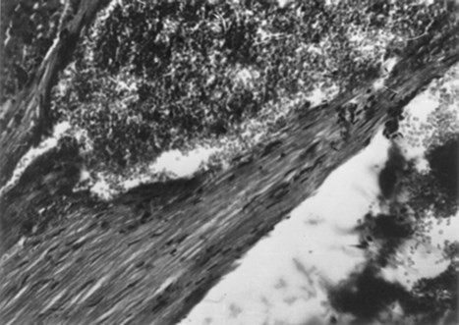
Prospects of colon cancer screening and treatment
Antiseptic method of 1-moment colon resection
4. Palpatory intestinal trauma – the second reason of anastomotic leak
On-table intestinal lavage [17] requires palpatory intubation of intestine, emptying without intubation - “milking". The refusal from these manipulations in favor of unloading stomas is argued by intestinal trauma, drop in blood pressure during and after palpation, clogging of tubes, threat of contact sores [18].
The picture of palpatory trauma was received by experiments; microscopy study of canine’s intubated intestines preparations revealed a gross damage of all its layers [19]. It is important that the healing of anastomosis is affected not only by the physical intestinal trauma, but also by the neuro-reflex reaction to it, expressed by vasospasm, ischemia .
Intubational intestinal trauma:
stratification of mucosal and muscular layers
Intubational intestinal trauma:
hematoma of muscular layer
© Reference on www.coloncancer.lv is obligatory

Slide 5
Prospects of colon cancer screening and treatment
Antiseptic method of 1-moment colon resection
5. Ideology and differences of Antiseptic method
The novation is devoted in memory of my grandfather, Sarkys Abramyanc from Van, who died after surgery on sigmoid colon.
The method is intended to prevent the leak of colon anastomosis. It is actual, first of all, in case of urgent resection, conducted in connection with ileus. The essence of prevention lies in:
1. Intensive antegrade lavage of intestinal cavity in course of operation.
2. Extended irrigation and aspiration of intestinal cavity during post-operational period.
Postoperative irrigation will provide X-ray control of anastomosis tightness and lavage of mucosa; continuous aspiration will exclude gases and liquid in an intestinal cavity, will provide a flat state of intestine and closing of anastomosis mucous lips and, as a result, its healing by primary and even by secondary tension.
Lavage, irrigation and aspiration of intestines are realized by new systems integrated into the complex Intestinal Intubator with Drain-Irrigator (IIDI) [20-28], as well as new 1-moment colon resection. New systems are distinguished by:
Atraumatic transanal intubation of the intestine at the required depth.
Intensive flow of fluid delivered to the endpoint of intubation.
Dosed fluid delivery along all the intubated intestine.
100% reliability of emptying and aspiration of the intubated intestine.
The new 1-moment colon resection is different by:
Technical connection of resected colon ends.
Transanal intubation and lavage of resected colon.
Disconnection of resected colon ends and application of anastomosis.
© Reference on www.coloncancer.lv is obligatory

Slide 6
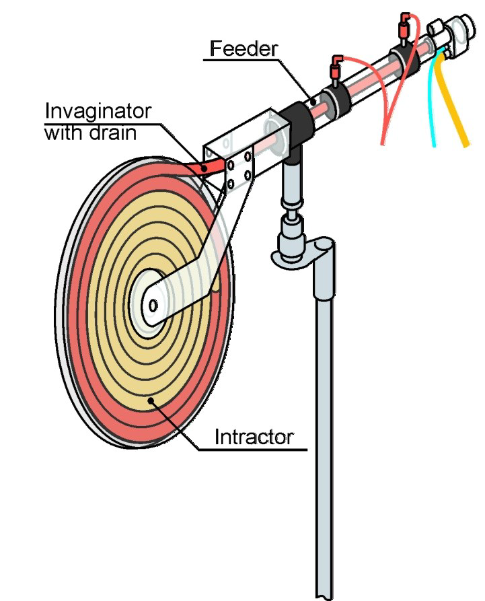
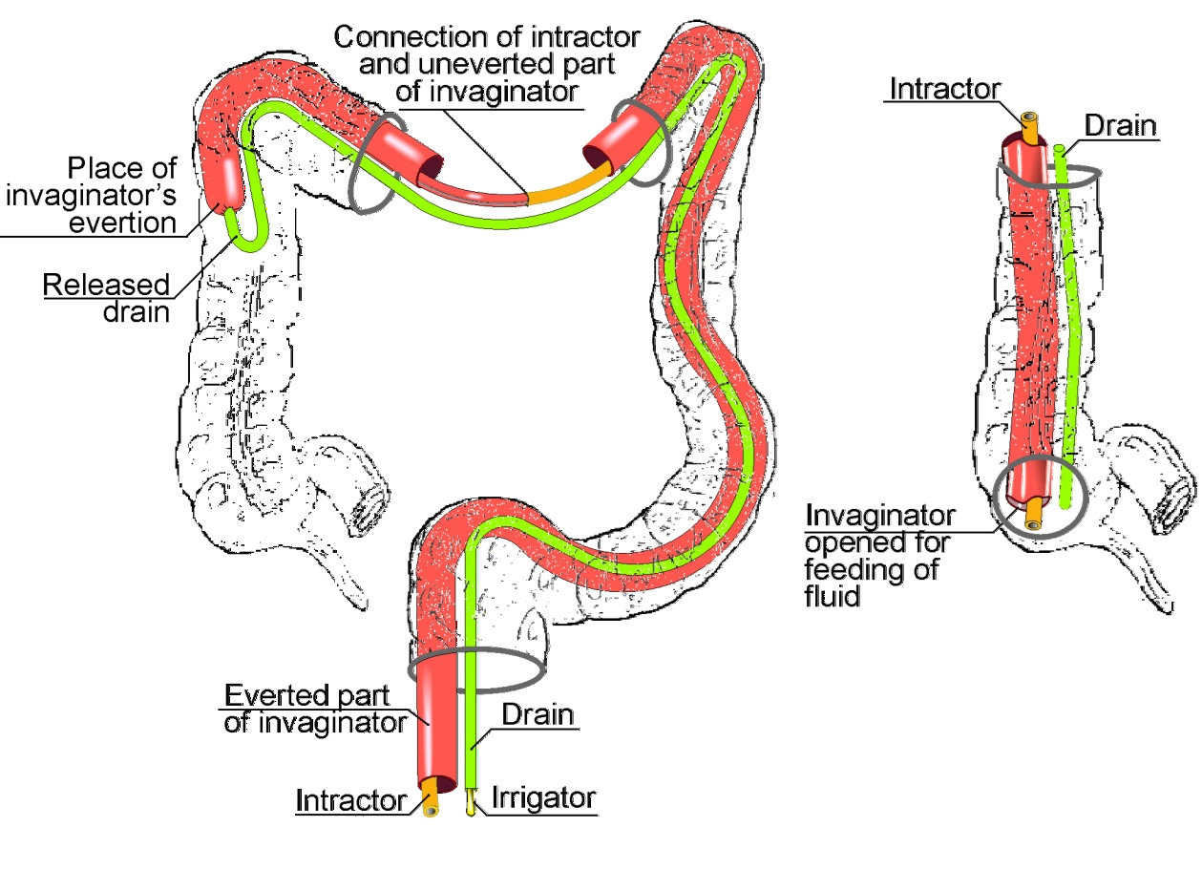
Prospects of colon cancer screening and treatment
Antiseptic method of 1-moment colon resection
6. IIDI; intubational system “Pull-&-Push”
Atraumatic transanal intubation of large intestine is carried out by 2 forces that cooperate under the "pull-&-push" principle. The "pull" force is created by an invaginator, which everts out like a finger of gloves; together with the drain enclosed therein, it is rolled onto the mucous surface. Source of "push" force is the mechanism that feeds invaginator with drain and then intractor into the everted and inflated part of the invaginator.
Coil
© Reference on www.coloncancer.lv is obligatory

Slide 7
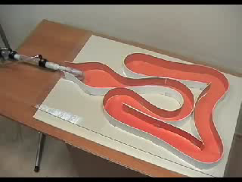
Prospects of colon cancer screening and treatment
Antiseptic method of 1-moment colon resection
7. IIDI; intubation management
Intubation of the intestine (see record) is performed by surgeon by periodically pressing the pedal of the feeder mechanism; by hands he controls direction of invaginator’s evertion. The intubation step is 5-10 cm, the total duration is no more than 1 min.
To watch
the video
click on photo
© Reference on www.coloncancer.lv is obligatory

Slide 8


Prospects of colon cancer screening and treatment
Antiseptic method of 1-moment colon resection
8. IIDI; lavage system “Stream”
The basis of the system is an everted invaginator, opened after intubation to the endpoint of intubation (see slide 5 on the right). Its diameter (18 mm) will provide a stream of lavage fluid with a speed of up to 10 l/min; after filling, for example, the cecum, it flows down along the colon into the rectum, and then into the pipeline and the receiving container, carrying with it intestinal miasmas. On-table lavage up to "clean water" requires dozens of liters of liquid, its level above the intestines can be about 5-10 cm wg.
© Reference on www.coloncancer.lv is obligatory

Slide 9
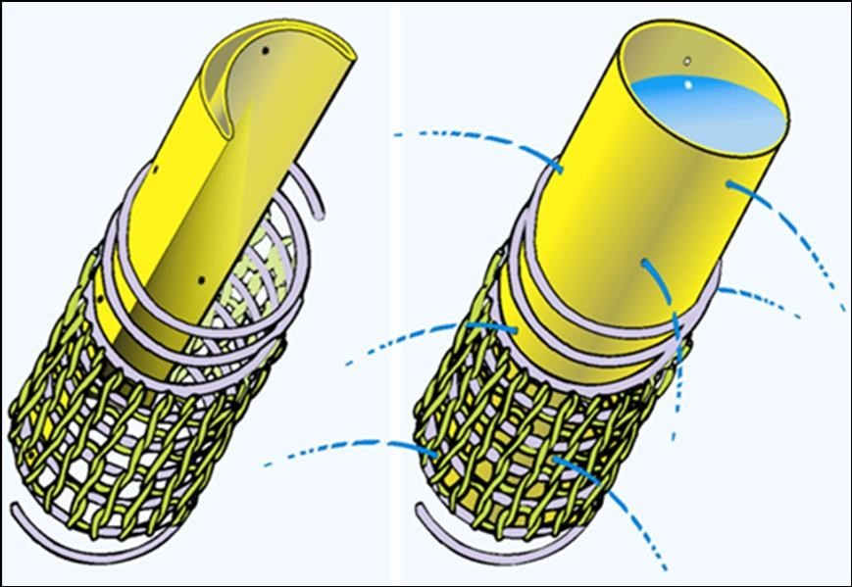
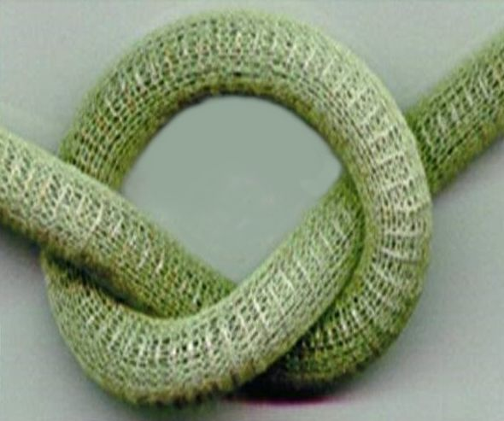
Prospects of colon cancer screening and treatment
Antiseptic method of 1-moment colon resection
9. IIDI; aspiration system “Drain-Irrigator”
The system includes a sleeve, punctured along the circumference and length, enclosed in a flexible spiral-net drain [22]. Feeding of a fluid into the sleeve will squeeze out the contents of drain, and washes its mesh. Such recanalization of drain guarantees full emptying of intestines before application of anastomosis, lavage and aspiration of intestinal cavity in post-operational period; the sleeve could be also used for feeding of the radiocontrast fluid, and thus – for checking of anastomosis tightness. A local lavage of caecum, which is required in connection with the receipt of ileum contents, will be provided by the Intractor tube (see slide 5 on the bottom right).
© Reference on www.coloncancer.lv is obligatory

Slide 10
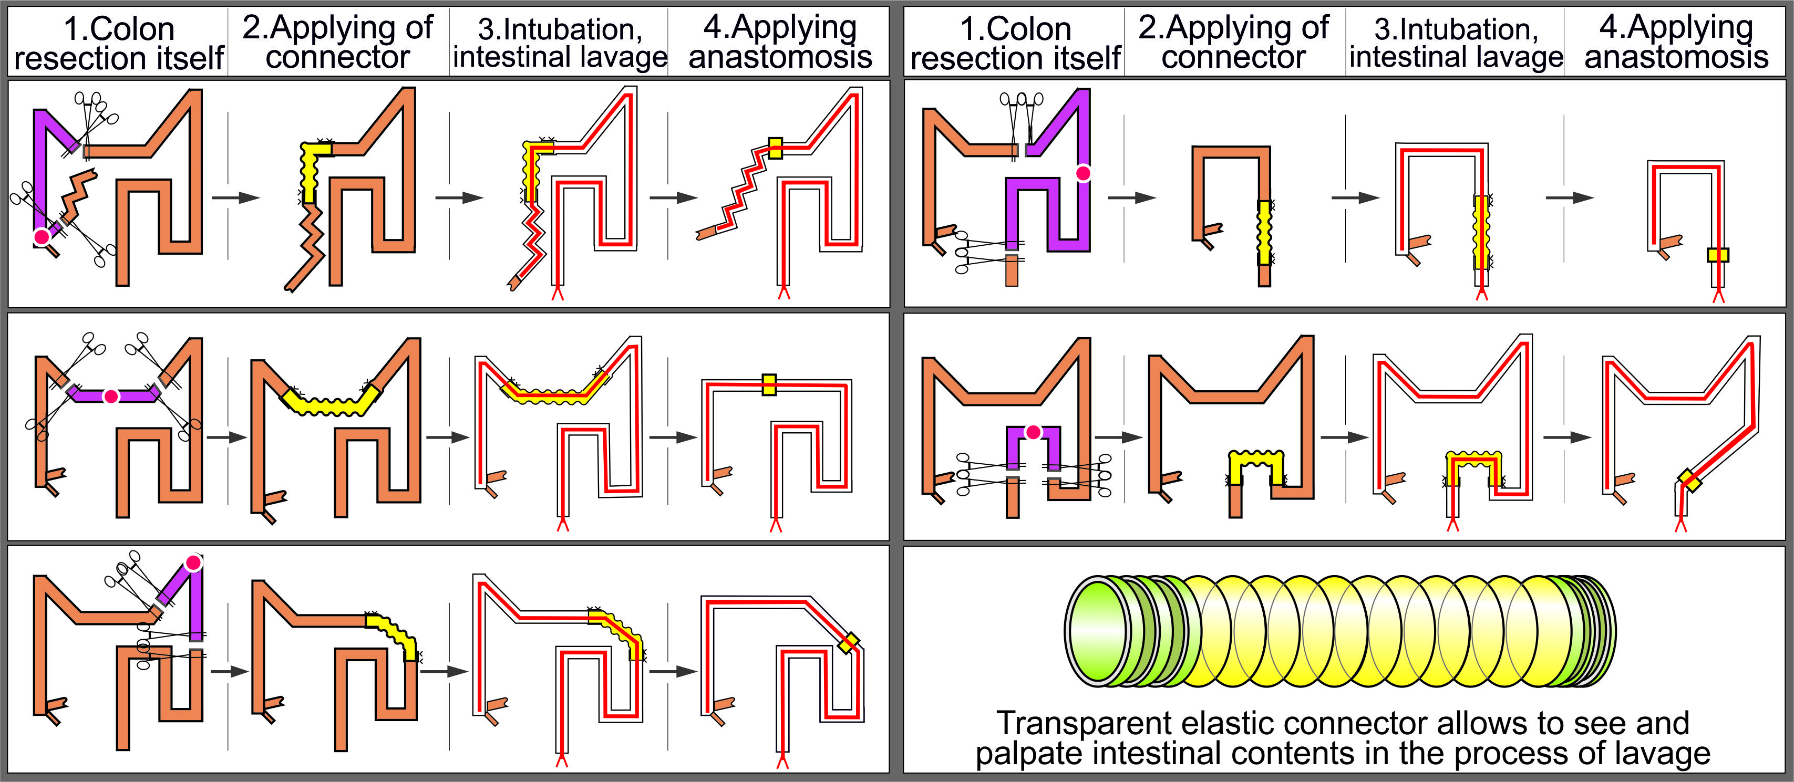
Prospects of colon cancer screening and treatment
Antiseptic method of 1-moment colon resection
10. Algorithm of new 1-moment colon resection
The new resection consistently includes :
Colon resection [29] itself according to one of the 5 classic variants [30].
Technical connection of the resected intestine’s ends by means of a connector.
Intubation and lavage of technically connected colon.
Removal of connector and manual application of anastomosis bypassing inserted elements.
By p. 4: Putting of a mechanical suture will require extubation and re-intubation.
© Reference on www.coloncancer.lv is obligatory

Slide 11
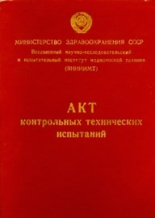
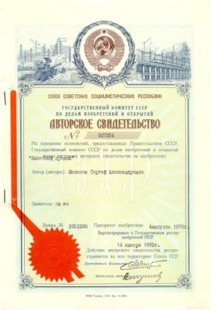

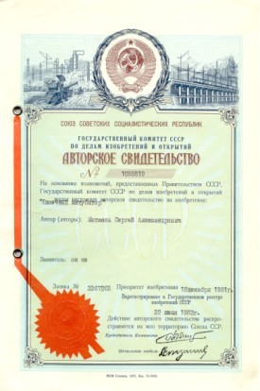
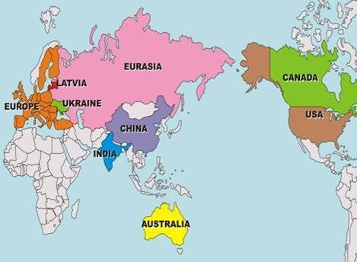
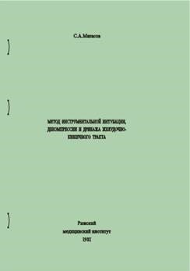
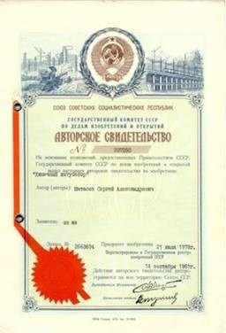

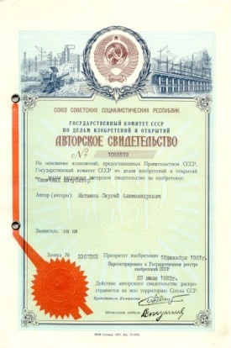
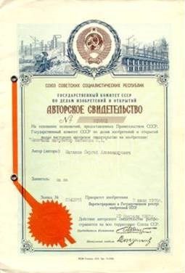
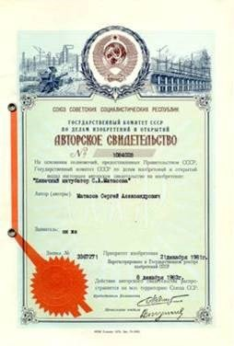

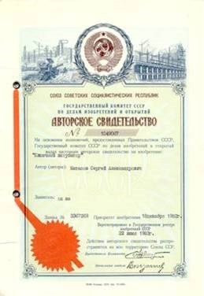
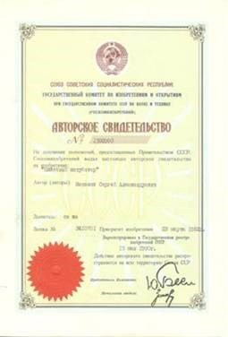

Prospects of colon cancer screening and treatment
Antiseptic method of 1-moment colon resection
11. Clinical estimation of Antiseptic method
By the request of prof. E.A.Babayan, chairman of the Committee on New Technologies of the USSR Ministry of Health, the Department of Hospital Surgery of 2nd MMI realized the clinical estimation of the Method. On February 23, 1983, docent A.A.Grinberg has given the following report: "This method has given a good clinical effect and could be recommended for the treatment of patients suffering from acute intestinal obstruction, peritonitis, to protect anastomosis during operations on colon tumors".
C.Матасов
Проблемы
и перспективы интубации кишечника
РИГА 1992
USSR Author certificates, 1974-1986
Countries of patenting; 2002-2012.
© Reference on www.coloncancer.lv is obligatory

Slide 12
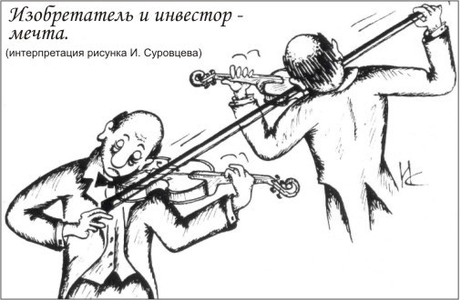
Prospects of colon cancer screening and treatment
Antiseptic method of 1-moment colon resection
12. Conclusion
1. 1-moment resection requires a clean large intestine, all other resections comprise actions, aimed at post-operative removal of intestinal contents, but today both primary and secondary anastomoses, as well as unloading stomas are leaking.
2. The leak of intestinal sutures is a consequence of violation of the basic rules of surgery: aseptics, antiseptics, atraumatic manipulations. The proposed Method by means of atraumatic measures: intraoperative intubation and intensive lavage of the resected colon, its irrigation and aspiration after operation, prevents the leak of anastomosis.
3. Taking into account the high mortality from large intestine cancer, the quality of life of patients with colostomy, the number and price of performed operations, there is no alternative to the Method, so it can count on a broad clinical implementation.
Ideal partnership
Author interpetation
of I.Surovtsev sketch
© Reference on www.coloncancer.lv is obligatory

Slide 13
Prospects of colon cancer screening and treatment
Antiseptic method of 1-moment colon resection
13. Main sources of information
www.ncbi.nlm.nih.gov/pubmed/23913315 Primary anastomosis with a defunctioning stoma versus Hartmann’s procedure for perforated diverticulitis
– a comparison of stoma reversal rates. Alizai PH et al., International Journal of Colorectal Diseases, 03.08.2013.
http://www.ncbi.nlm.nih.gov/pubmed/22750427 Mortality following Hartmann’s procedure – correlation of Dr. Foster’s report with CR-POSUM. Neeraj Lal et al., Research Gate, United Kingdom, June 2012.
http://ar.iiarjournals.org/content/30/2/601.long Reducing Anastomotic Leakage in Oncologic Colorectal Surgery: An Evidence-Based Review. Mark
et al., Anticancer Research, February 2010.
https://jamanetwork.com/pdfaccess.ashx?ResourceID=5353554&PDFSource=13 Anastomotic Leak After Low Anterior Resection. Hannah Caulfield
et al., JAMA Surgery, 2013.
http://www.ncbi.nlm.nih.gov/pubmed/20002697 Management and outcome of anastomotic leakage after colonic surgery. A. Rickert et al., Colorectal Disease. Vol.12, Issue 10, October 2010.
http://link.springer.com/content/pdf/10.1007%2Fs11605-013-2227-0.pdf Do we really know why colorectal anastomoses leak? Benjamin D.Shogan et al., Journal of Gastrointestinal Surgery, May 2013.
https://www.fascrs.org/video/complications-colorectal-surgery-core-subjects-2011 Complications in Colorectal Surgery. David W. Dietz, MD, American Society of Colon and Rectal Surgeons, 2011.
www.ncbi.nlm.nih.gov/pubmed/23426596 Anastomotic leak after low anterior resection: a spectrum of clinical entities. Caulfield H, Hyman NH. JAMA Surgery, February 2013.
http://www.ncbi.nlm.nih.gov/pubmed/23398601 Late anastomotic leakage in colorectal surgery: a significant problem. A.N. Morks et al., Colorectal Disease, Vol.12, Issue 5, April 2013.
https://www.ncbi.nlm.nih.gov/pmc/articles/PMC4882170/ Management of Colorectal Anastomotic Leak. Michael S. Thomas and David A. Margolin, Clin Colon Rectal Surg. 2016 Jun; 29(2): 138–144.
https://cyberleninka.ru/article/n/hirurgicheskoe-lechenie-kishechnoy-neprohodimosti-u-bolnyh-obturiruyuschim-rakom-levyh-otdelov-tolstoy-kishki Хирургическое лечение кишечной непроходимости у больных обтурирующим раком левых отделов толстой кишки, Д.Е.Попов и др., Вестник Санкт-Петербургского Университета, Сер. 11, Вып.2, 2009.
www.docguide.com/risk-factors-associated-surgical-site-infection-after-ileal-pouch-anal-anastomosis-ulcerative-coliti?tsid=5 Risk factors associated with surgical site infection after ileal pouch-anal anastomosis in ulcerative colitis. Tomita N. et al., Diseases of Colon and Rectum, 53(2), 2010.
www.ncbi.nlm.nih.gov/pubmed/21748610 Association between incisional surgical site infection and the type of skin closure after stoma closure.
Kobayashi S. et al., Surgery Today, 41(7), July 2011
http://www.coloclean.de
15. http://212.67.216.33/retrowash.html
http://www.crie.ru/vbi2/1-4-01.pdf Cелькoва Е.П. Гренкова Т.А., Проблемы инфекционной безопасности в гибкой эндоскопии, 2010.
http://www.medkursor.ru/biblioteka/oslojnenyi_rak_obod_kishki/lechenie_rak/12835.html Декомпрессия межкишечного анастомоза
в профилактике его недостаточности. «Осложнѐнный рак толстой кишки». Г.А. Ефимов, Ю.М. Ушаков, 1984.
http://medicalplanet.su/xirurgia/248.html Противопоказания к интубации кишечника. Ретроградная интубация кишечника.
Матасов С.А., Ильинский И.М. Морфологические изменения кишечника при его интубации в эксперименте. Хирургия, 1982,10, с. 42-44.
http://worldwide.espacenet.com/publicationDetails/originalDocument?FT=D&date=20080514&DB=EPODOC&locale=en_EP&CC=EP&NR=1615539B1&KC=B1&ND=4 Matasov S., Disposable Intestinal Intubator with Drain and Irrigator, European patent ЕР1615539, 14.05. 2008
http://worldwide.espacenet.com/publicationDetails/originalDocument?FT=D&date=20080514&DB=EPODOC&locale=en_EP&CC=EP&NR=1615 539B1&KC=B1&ND=4 Матасов С.А., Одноразовый интубатор колон с дренажом и ирригатором, Евразийский патент № 010137, 30.06.2008.
Матасов С.А., Кишечный дренаж, авторское свидетельство СССР № 927254, 1982. Бюллетень 18.
© Reference on www.coloncancer.lv is obligatory

Slide 14
Prospects of colon cancer screening and treatment
Antiseptic method of 1-moment colon resection
Home
14. Main sources of information
http://worldwide.espacenet.com/publicationDetails/originalDocument?FT=D&date=20080630&DB=EPODOC&locale=en_EP&CC=EA&NR=010137B 1&KC=B1&ND=4 Matasov S., Disposable Intestinal Intubator with Drain and Irrigator, patent of Canada CA2493909, 31.12.2003.
http://worldwide.espacenet.com/publicationDetails/originalDocument?CC=AU&NR=2003264913A1&KC=A1&FT=D&ND=5&date=20040106&DB
=EPODOC&locale=en_EP Matasov S., Disposable Intestinal Intubator with Drain and Irrigator, patent of Australia AU2003264913, 31.07.2008.
http://worldwide.espacenet.com/publicationDetails/originalDocument?FT=D&date=20091230&DB=EPODOC&locale=en_EP&CC=CN&NR=10 0574818C&KC=C&ND=4 Matasov S., Disposable Intestinal Intubator with Drain and Irrigator, patent of China CN100574818, 30.12.2009.
http://worldwide.espacenet.com/publicationDetails/originalDocument?FT=D&date=20071112&DB=EPODOC&locale=en_EP&CC=UA&NR=80 828C2&KC=C2&ND=4 Matasov S., Disposable Intestinal Intubator with Drain and Irrigator, patent of Ukraine UA80828, 12.11.2007.
http://worldwide.espacenet.com/publicationDetails/originalDocument?FT=D&date=20030320&DB=EPODOC&locale=en_EP&CC=LV&NR=12963B&KC=B&ND=4 Matasov S., Disposable anal Intubator with drainage and recanalizator-Irrigator, patent of Latvia LV12963, 20.03.2003.
Матасов С.А. Проблемы и перспективы интубации кишечника, book.pdf ,
Матасов С.А. Асептический способ 1-моментной резекции опухоли толстой кишки и устройство для его осуществления. Патентная заявка ЛР Р-12-66, 2012.
Ганичкин А.М. Рак толстой кишки, «Медицина», 1970, стр. 219.
© Reference on www.coloncancer.lv is obligatory

